Slide 1

N13 Entertainment
Application User Guide
By
Nikheel Manhar Asodia

Slide 2
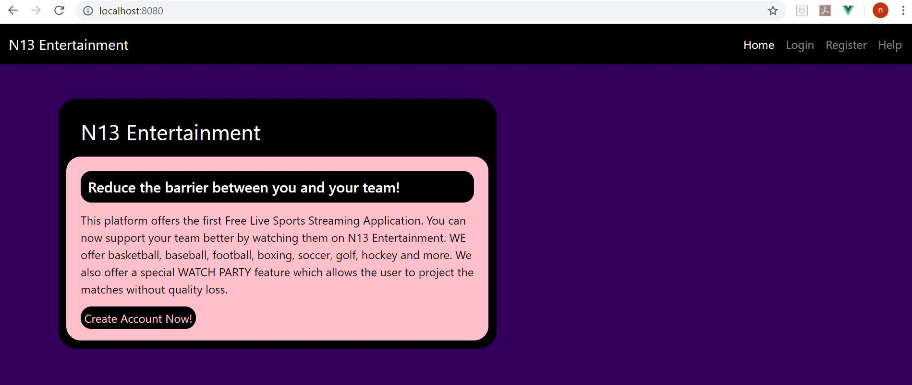
Welcome to N13 Entertainment

Slide 3
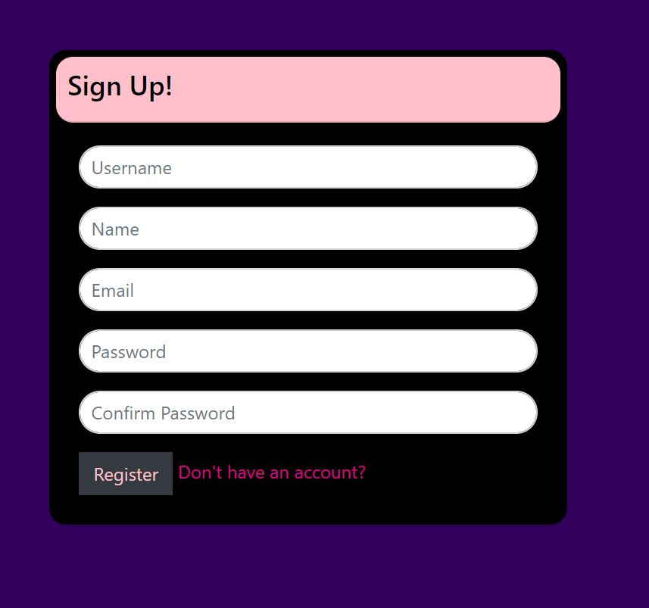
All the new clients would have to register with the platform before they can use our services.
Users would have to provide basic and unique information such as username.
The registration is highly secured by authentication.

Slide 4
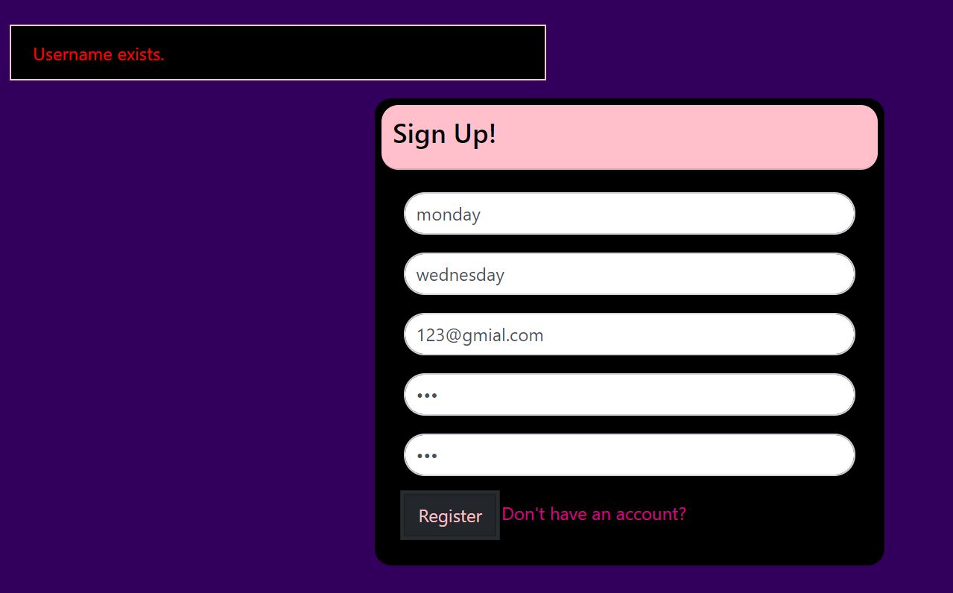
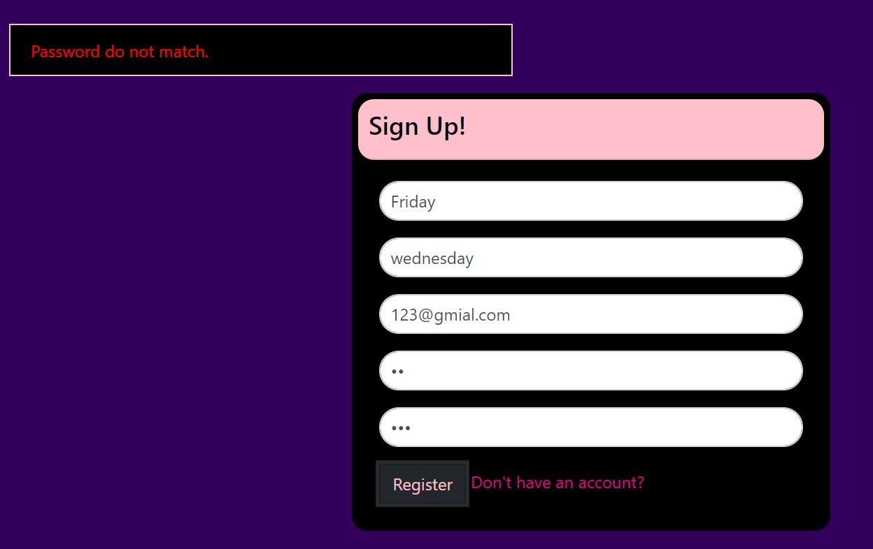
The users will be restricted from registration if they are using the same username.
Also, the password have to be same and meet the requirements.

Slide 5
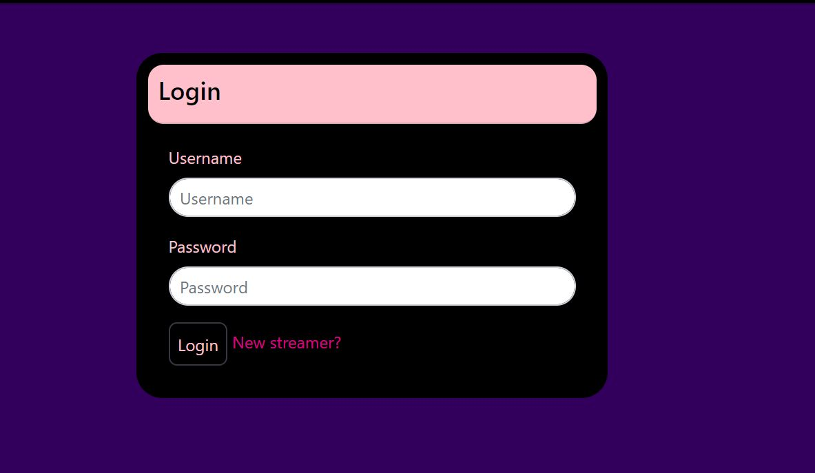
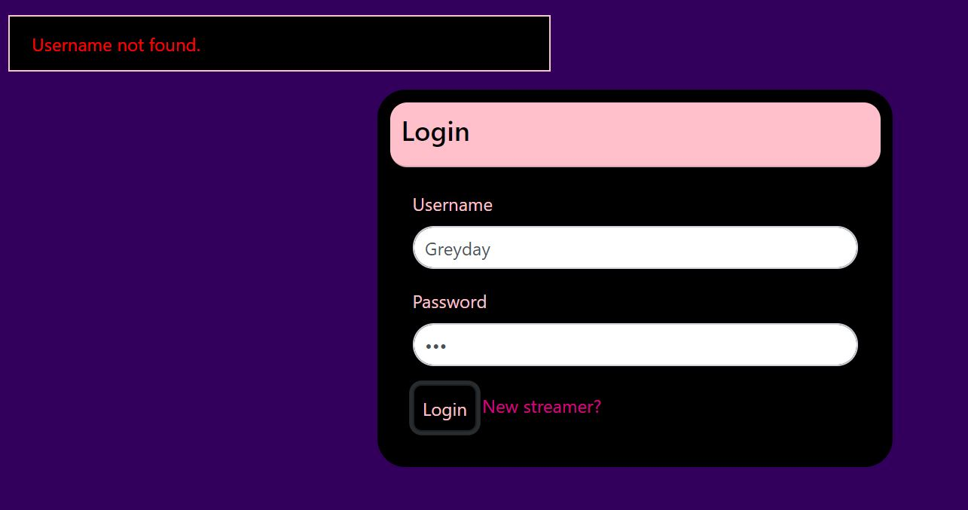
Upon successful registration, the application will take the user to the log in page.
The log in interface is also authenticated and secure.
If a user don’t have an account then he or she can just click the “New streamer” link.
It would take to the registration page.

Slide 6
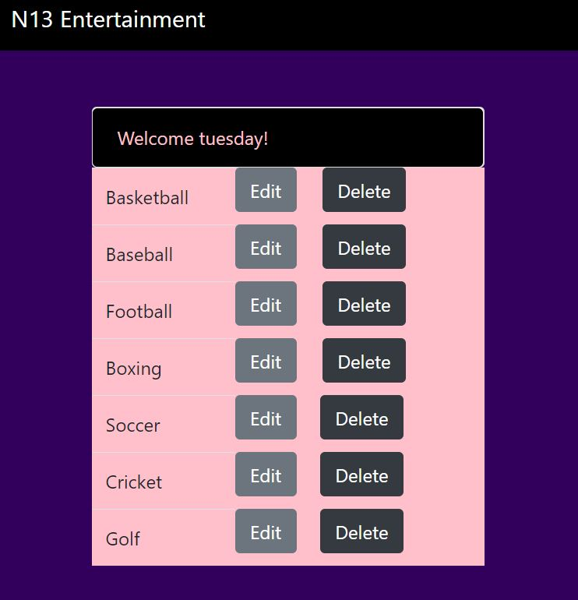
Upon registration the user will see their profile with a greeting and default set of sport categories.
Based on user choice, he or she can remove a category or edit and submit a request of an un-listed category.

Slide 7
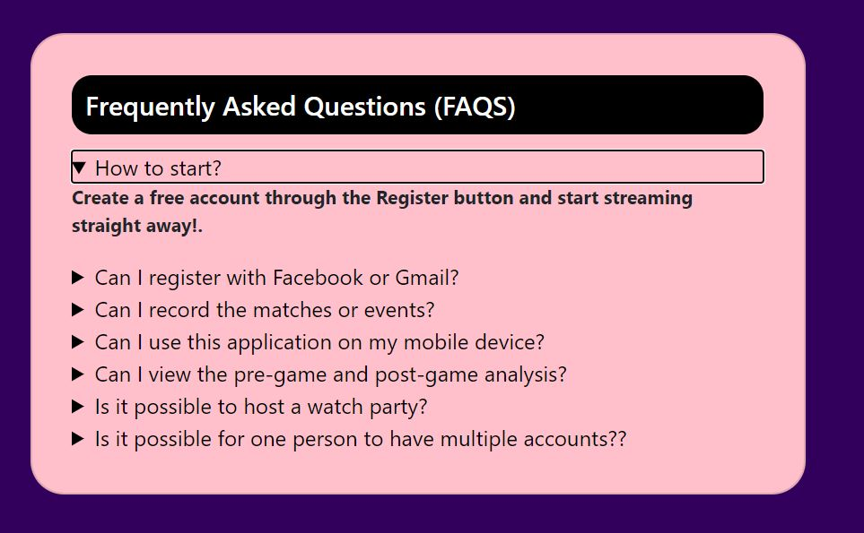
The application is pretty straight forward.
In case of any questions, we also have a help page with FAQ section.

Slide 8

N13 Entertainment

